Slide 1
Projects In MongoDB
Angular 2 & The MEAN stack

Slide 2
What Is MEAN?
Mongo – NoSQL Database
Express – Server Side Framework
Angular – Client Side Framework
Node.js – JavaScript Runtime

Slide 3
What Is Angular 2?
A full featured JavaScript front-end framework
Built and maintained by Google
Desktop and mobile web applications
Uses TypeScript language
Much different than AngularJS / Angular 1

Slide 4
What The Core Angular 2 Package Offers
Routing
HTTP Module – Get, Post, Put, Delete Requests
Rxjs / Observables
Dynamic Templates
Event System
LifeCycle Hooks
Testing
And More!

Slide 5
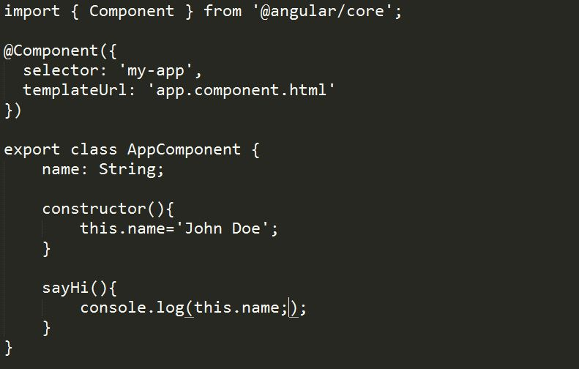
Components
Treat everything as a component
Encapsulates functionality

Slide 6
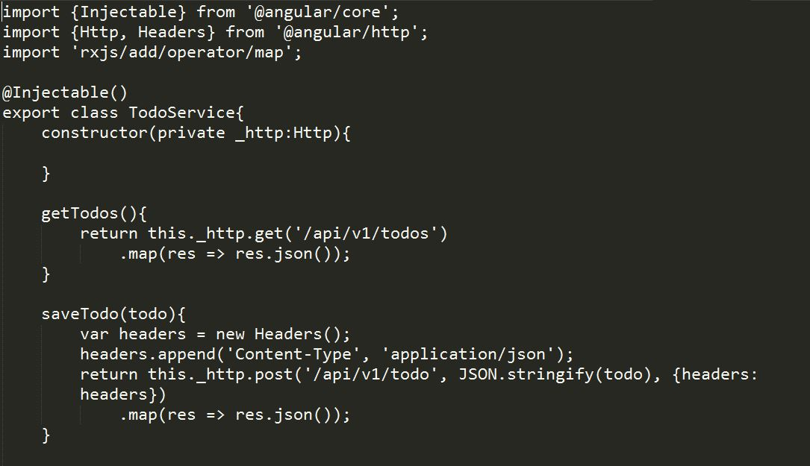
Services
Services can be accessed from all components
All external requests should go in a service
Can return observables

Slide 7
Angular CLI
Tool to generate a boiler plate application
Run dev server
Compile project
npm install –g angular-cli
ng new myapp
ng serve
ng build

Slide 8


